Slide 1
Team (2+2=5)
1/7
EXL EQ-21
Forecasting Covid-19 cases at a country level
ADITYA SHENOY | SINJINI ROY

Slide 2
TEAM 2+2=5 | EXL EQ-2021
2/7
Key Presentation Points
Executive Summary
Solution Design
Development Process
Key drivers of the Model & Validation results
Top 5 states expected to be worst affected by Covid-19
Vaccination Strategy

Slide 3
TEAM 2+2=5 | EXL EQ-2021
3/7
Solution
Design
Problem
To develop a tool for a US public health client to predict daily Covid-19 cases at a country level.
Used the provided dataset to develop a model which can forecast the number of new Covid-19 cases at a country level.
Executive
Summary
What we know!
Dataset containing the information about country-wise Covid-19 information updated till January, 2021.
Used XGBoost Regressor model to predict the number of daily new Covid-19 cases.
What we need to find?
To develop a model which can forecast the number of daily new Covid-19 cases at a country level.
Used fbprophet procedure for forecasting time series data based on an additive model to predict future observations.

Slide 4
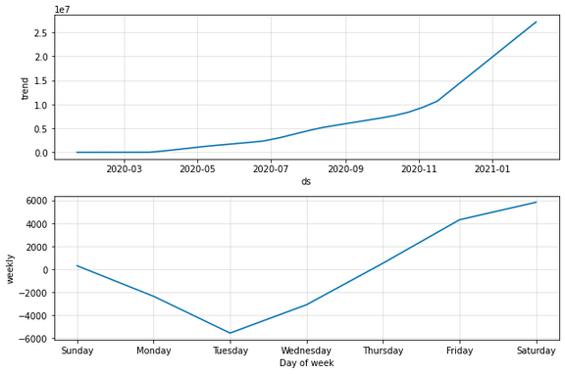
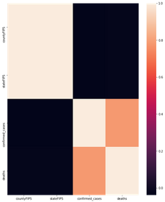
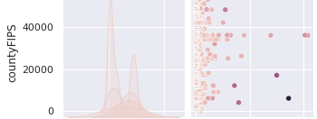
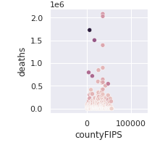
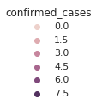
TEAM 2+2=5 | EXL EQ-2021
4/7
Developmental Process
Forecasting Developmental Process
Modelling Developmental Process
Data Preprocessing
Data Modelling
Data Prediction
Analyzed the dataset over the features 'Confirmed Cases' and 'Number of deaths' and applied the Fbprophet procedure for forecasting time series data based on an additive model where non-linear trends were fitted on the 'Date' feature.
Preprocessed the data, treated the NaN values and found the correlation heatmap between various features to identify the statistically significant ones.
Used XGBoost Regressor for optimal performance to predict the daily Covid-19 cases as it involves training and combining individual models to get a single prediction.
Model Prediction on Test Data. Gives a probability score on each prediction.

Slide 5
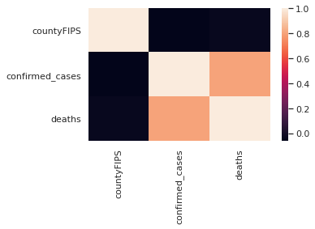
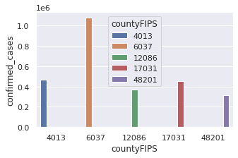
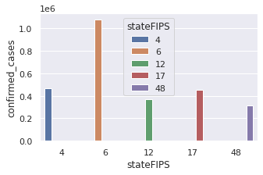
TEAM 2+2=5 | EXL EQ-2021
5/7
Key drivers of the Model
01
countryFIPS
Predicted the number of Confirmed Cases by the 5-digit Federal Information Processing Standards Code which uniquely identifies countries.
02
stateFIPS
Predicted the number of Confirmed Cases by the 2-digit Federal Information Processing Standards Code which uniquely identifies states.
03
date
Mapped the dates into ordinal values to predict the model based on the feature.
91.97%
Training Accuracy
Validation
Results
91.48%
Test Accuracy

Slide 6
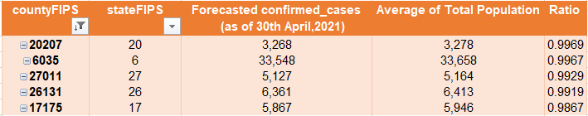
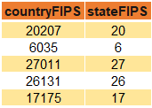
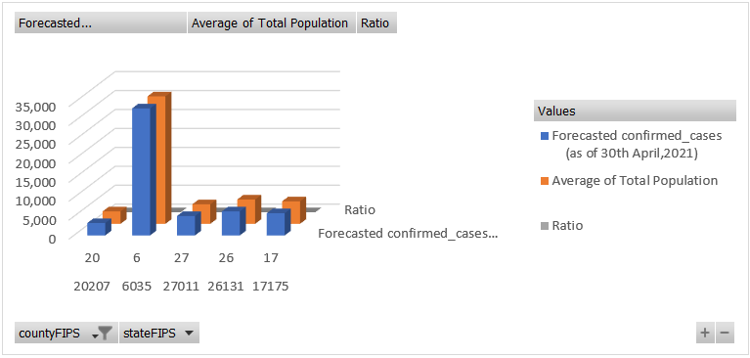
TEAM 2+2=5 | EXL EQ-2021
6/7
Top 5 States expected to be worst affected by
COVID-19

Slide 7
TEAM (2+2=5) | EXL EQ-2021
7/7
Vaccination Strategy
Setting up a unified vaccination strategy system
Communication Strategy
INFORMATION ON THE NEW COVID-19 VACCINE
VACCINE HESITANCY
Training & Awareness
Unified Digital Platform
Provide prompt, simple and focused communication on the COVID-19 vaccine(s) and vaccination processes.
Building public confidence in the safety and efficacy of the new vaccine.
07
Training authorized vaccinators on how to vaccinate and how to explain side effects.
Awareness programs for the vaccine-agnostic masses through various media.
Setting up a unified digital platform system for trouble-free vaccination procedures for both the public as well as healthcare officials.
VACCINE EAGERNESS
COVID APPROPRIATE BEHAVIOURS
Ensure understanding and acceptance of the phased and prioritized approach to overcome concerns of the population waiting for vaccination.
Maintain and sustain key preventive behaviors: wearing masks, maintaining physical distance, and handwashing with soap.
Network of Vaccination centres
Slot Booking
Set up a network of public and private vaccination centers with trained vaccinations and proper infrastructure.
Vaccination centers could be Govt sponsored or hospitals, corporates or pharmacies, all registered onto the unified application technology.
The public can book slots for vaccination through mobile app/ through e-service centers and get their vaccination done in nearby centers.
Slot booking will be conducted phase-wise based on age & health parameters.
Initial Target Audience
Health care workers
Frontline functionaries
People over 50 yrs of age
People under 50 yrs with co-morbidities

